Slide 1

Crypto For Dummies
Team 20 4/29/2022
Daniel Tu
Lawrence Wang
Jonathan Lei
Tanya Krishan
Tiffany Natasha
Notes:
Daniel - meet the team slides

Slide 2
43,509
Notes:
Daniel - add more context about how much money

Slide 3

PROBLEM:
Retail Investors are losing billions of dollars due to misinformation in the Crypto Market
Notes:
Daniel - misinformation, maybe add a competitor that is really bad

Slide 4
THE PROBLEM IS ONLY GETTING WORSE...
Pump and dump schemes generated $2.8 billion in revenue in 2021
Trustworthy information is getting harder and harder to acquire
… BUT THAT MEANS THE MARKET IS RIPE.
PUMP AND DUMPS
General population is relatively clueless about cryptocurrencies:
90% don’t know Bitcoin supply is capped
98% don’t know basic crypto concepts
Trustworthiness, Simplicity, and Value are the main deciding factors for information sources
TIME
Source: Yahoo! (n.d.). Crypto comprehension study: 98% of people don't grasp basics of bitcoin, stablecoins or nfts. Yahoo! Retrieved April 22, 2022, from https://www.yahoo.com/video/crypto-comprehension-study-98-people-190349019.html
Notes:
Lawrence - more specific to what problem

Slide 5



Customer Interviews
New Market,
so hard to understand without prior knowledge
Lack of Market Transparency
Information Asymmetry
Notes:
Tanya
Through our customer interviews, we talked to alot of people who have an interest in investing, but were wary of doing so due to a lack of transparency in the market and asymmetric information. The market is fairly new, so it’s hard to understand existing information without prior knowledge - due to which people end up following the “market trend” and end up buying what everyone else is without much knowledge

Slide 6

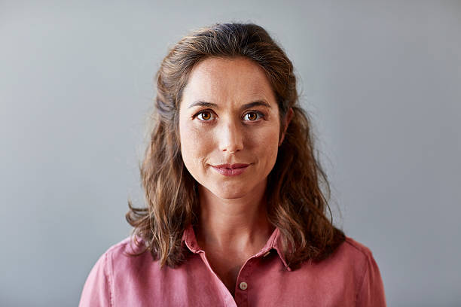
Personas
Tim
Age: 22
Tim just got a job signing bonus, so has excess of money in his bank account for the first time.
All of his friends are telling him about how much money they made in crypto.
He tries to do some research before, but realizes that there are too many sources, and all of them say different things.
He wonders if there is misinformation about this subject.
May
Age: 35
May is a mom of two, and is a manager at a large tech company.
She just got a promotion and is thinking about using her extra money to create a fund for her children.
She believes that crypto might return a lot more than stocks in the future.
She doesn’t know where to start looking to understand cryptocurrencies.
Notes:
Daniel - change to bullets, instead of summary

Slide 7
Our Solution
A CRYPTO WEBPAGE WITH RATINGS AND DATA-ANALYSIS WHERE USERS CAN:
Obtain Accurate Information
Intuitively Navigate Through
Make Informed Decisions
Notes:
Tanya
Through our real time news and crypto-compare data
with the user friendly interface
based on our sentiment analysis

Slide 8






COMPETITORS
SIMPLE
US
binance
coinbase
HIDDEN
TRANSPARENT
crypto.com
MetaMask
Weiss
COMPLEX
kraken
Notes:
Lawrence - add names of companies

Slide 9
LET’S SEE HOW IT WORKS.
Prototype: Anvil app
Notes:
Tiffany

Slide 10

Notes:
Daniel - add more context about how much money

Slide 11
SYSTEM ARCHITECTURE
Possible Inputs Code Blocks
Possible Output Code Blocks
Compute: Logical and Statistical
Crypto Compare
Tables Updates
Predict / Classify
Extract Insight
Web
App.
Logic
Data API
Anvil
Other Datasets
Pandas: Short
Term Storage
Display Box
Long Term Storage: SQL and File Formats (JSON, CSV, Excel)
Feedback from External System (World)
Notes:
Tiffany

Slide 12



GO-TO-MARKET STRATEGY
PHASE 1
BETA TEST @ BERKELEY
PHASE 2
UC Berkeley students are most importantly reachable, but also relatable, tech-savvy, and ready to invest their extra cash.
COLLEGE CAMPUSES
PHASE 3
College students are the population that is most
trusting of new services. Many are very willing to learn new information.
WORKING PROFESSIONALS
Working professionals will have the most side cash to invest in, so we will build out our brand first, and then reach out to them.
Notes:
Jonathan

Slide 13
ROLL-OUT PLAN
PHASE 1
PHASE 2
PHASE 2.5
PHASE 3
Build MVP
UC Berkeley Beta Test
All Colleges in the US
Working Professionals
PHASE 1: BERKELEY
PHASE 2: US COLLEGES
PHASE 3: PROFESSIONALS
FACEBOOK GROUPS
SPROUL PLAZA
WORD OF MOUTH
INVESTMENT CLUBS
SOCIAL MEDIA CONTENT
BRAND PARTNERSHIPS
PAID AD CAMPAIGNS
COMPANY SUBSCRIPTIONS
CRYPTO EXCHANGE PARTNERSHIPS
MARKETING STRATEGY
Notes:
Jonathan

Slide 14

01
02
REVENUE
MODEL
FREEMIUM VERSION WITH LIMITED FEATURES
PREMIUM VERSION WITH EXTRA FEATURES UNLOCKED
Notes:
Tanya
Freemium version which gives the leaderboard, and some common coins
Premium version gives access to the crypto compare function, and access to the entire coin database

Slide 15
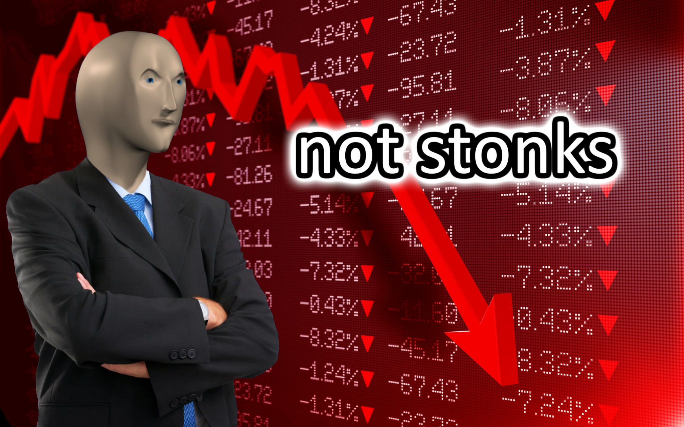
STOP MAKING MISINFORMED INVESTING DECISIONS
Notes:
Lawrence

Slide 16
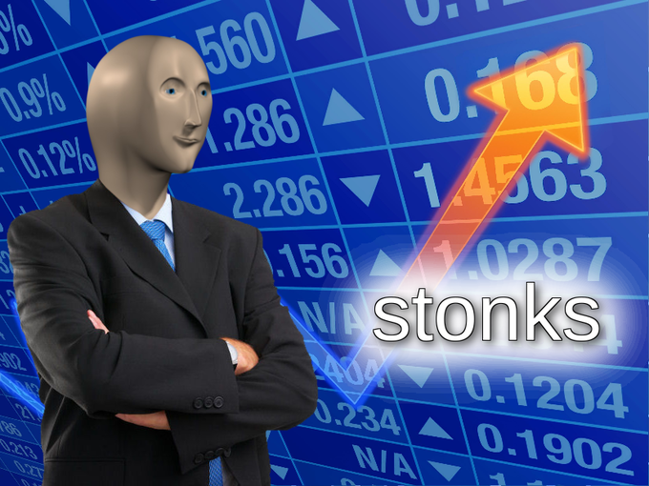
STOP MAKING MISINFORMED INVESTING DECISIONS
Notes:
Lawrence

Slide 17
MAKE INFORMED INVESTMENTS WITH CRYPTO FOR DUMMIES
Notes:
Lawrence

Slide 18
Need Approach Benefit Competition
Who needs it and why?
Retail investors with less resources at their disposal.
Crypto whales have sophisticated tools and more accurate information.
What approach will be used?
Pull API data (time-series price data and ratings) from cryptocompare
Web scrape twitter and github to gather external information and form a matrix for ratings
What is the benefit?
This will help retail investors understand the crypto market a little better. Providing information that can help them make a decision. We won’t specifically give advice, but provide easy to access info.
What is the next best alternative if this project was not done?
MorningStar Rating system
Weiss rating system
Why is this a good space? How will you win:
How will others in the industry react?
Large players like Coinbase, FTX and Kraken all provide some sorts of information on cryptocurrencies but they are focused on user-onboarding. Binance and tradingview have more sophisticated analysis that are tailored to advanced trader. They should not be largely affected by our product.
Business and/or technical strategy
Simplicity - Making it easy to understand will be our differentiating factor.
Transparency - Other rating systems rate in the back and return a rating, we will show our formula to calculate our ratings

